Slide 1

National Webinar on Transition from Proprietary to Open Source Technology
Chennai, Tamilnadu
12-03-2022

Slide 2

Version Control System Using GIT
Dr. Loganathan R
Prof & HOD
Department of Computer Science and Engineering
HKBK College of Engineering
Nagawara, Bengaluru-560045

Slide 3

Agenda
Overview on VCS
Introduction to Git & its Architecture
Installation and Configuration of Git
Working with Git Repository
Working with Git Branches
Basics of GitHub
Working with Git Remote Repository

Slide 4

Overview on VCS
Version Control System

Slide 5
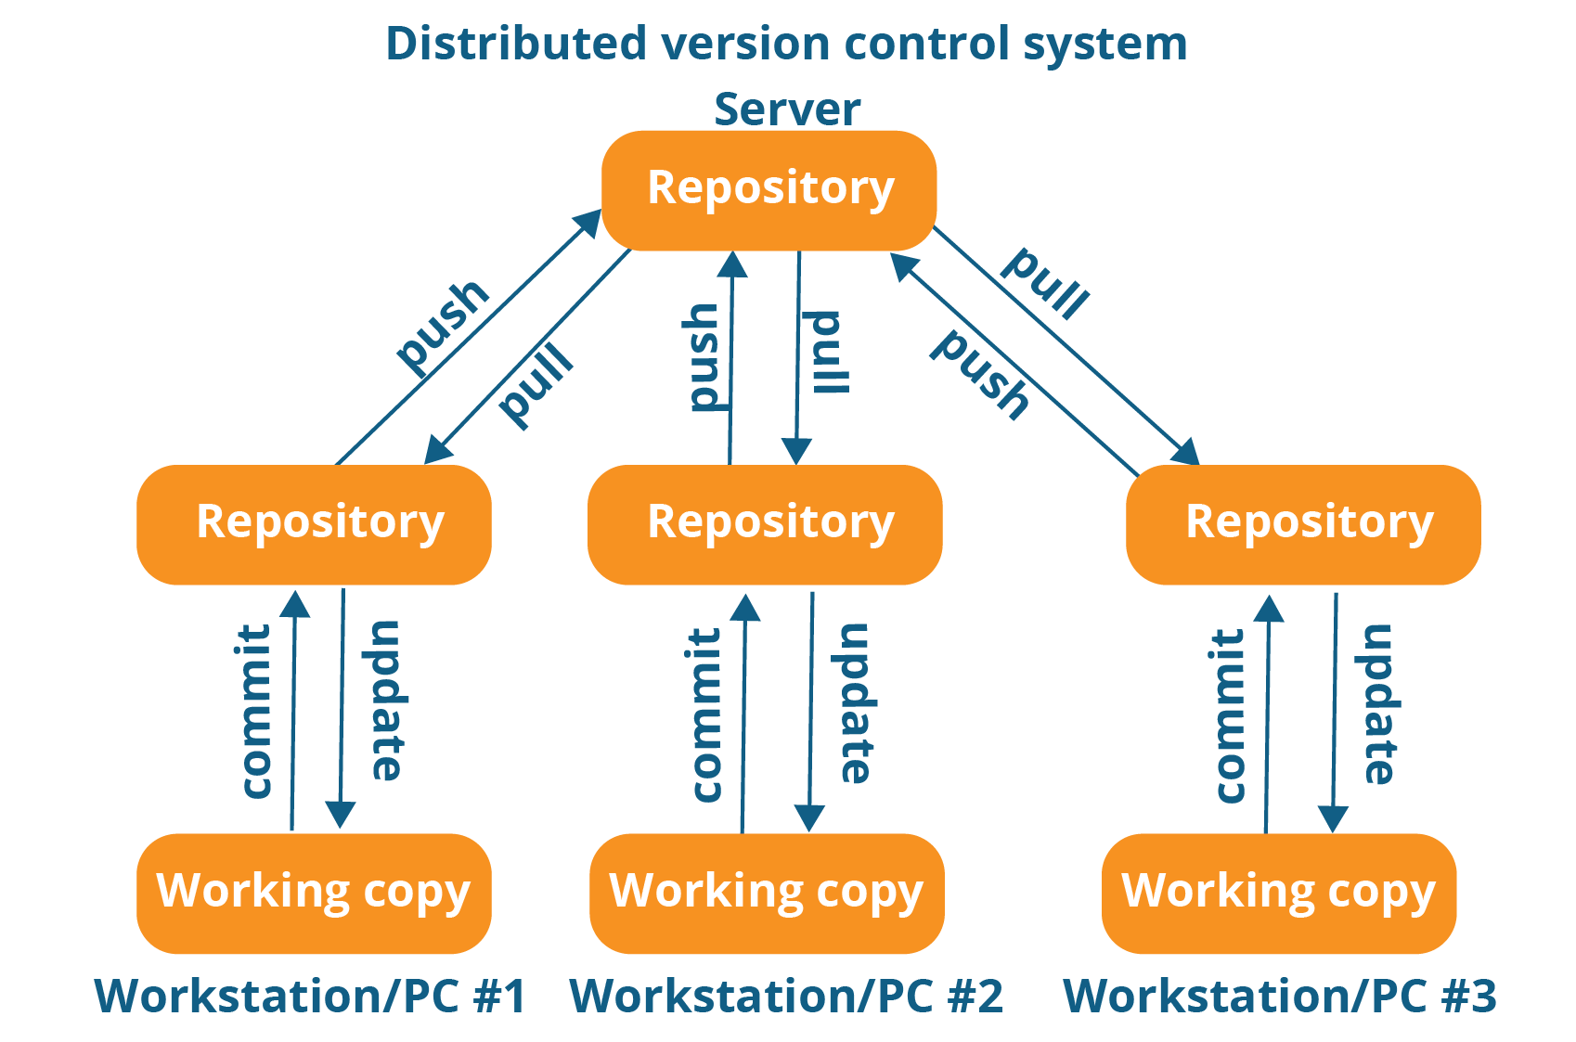
What is Version Control System ?
Version control, also known as source control, is the practice of tracking and managing changes to software code. Version control systems are software tools that help software teams manage changes to source code over time.
Benefits of VCS:-
A complete record of long-term change history of every file.
Branching and Merging in the Source Code
Tracing the changes in the Source Code.

Slide 6

Why is Version Control Needed?
Version control is important to keep track of changes — and keep every team member working on the right version. You should use version control software for all code, files, and assets that multiple team members will collaborate on.
Before VCS, UNIX users have a SCCS(Source Code Control System) to keep record of source code, but it huge demit was only one user can make changes in source code at a time.
Software issues without VCS or before it was introduced:-
Issues of lost Source Code.
While solving of bug, software can’t be upgraded.
Many version of same source code will be running on same time in a group.
No record of who have lastly edited the source code.

Slide 7
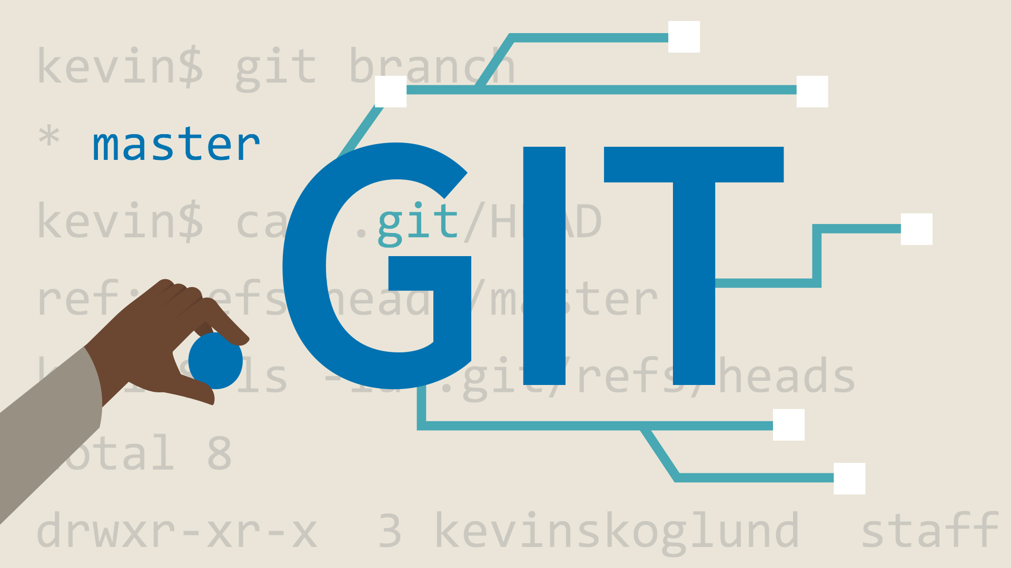
Introduction to Git & its Architecture
Git & its Architecture

Slide 8
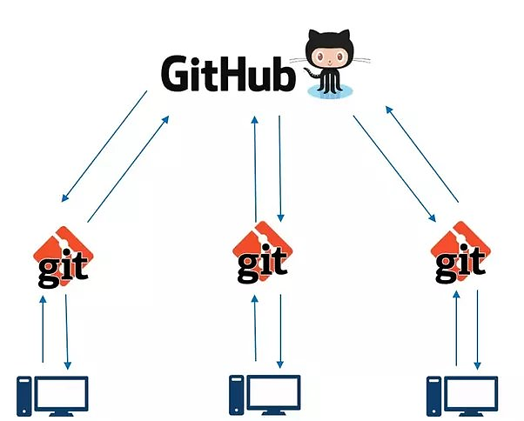
What is Git?
Git is a distributed version control system used for tracking changes in computer files. It was developed by Linus Torvalds, in April 2005. It is generally used for source code management in software development.
Features of Git:-
Tracks History
Free and Open Source
Supports non-linear development
Creates backups
Scalable
Support Collaboration
Branching is easier
Distributed development

Slide 9
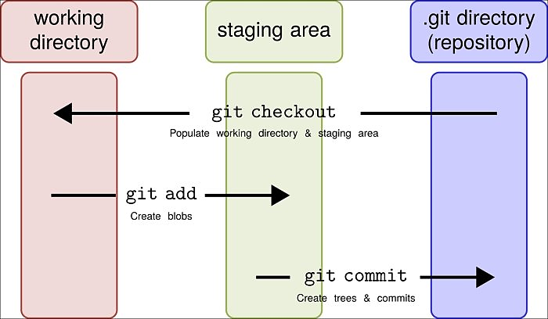
Git: Workflow
Git mainly works on Three Architecture Workflow, as its workflow is mainly divided into three states:
Working Directory:
Working Directory is place where the user modifies their files in their working directory.
Staging Area (Index):
Staging Area is place where user add snapshots of staged files after modifying their source code.
It stores those files which are supposed to go in next commit.
Git Directory (Repository):
Git Directory is a place where user stores the snapshots permanently after performing a commit in repository.
It stores all the commit and compress them.

Slide 10
Industry using Git
Company who are using git:
Netflix
Paytm
Shopify
Udemy
Reddit
Walmart
GitHub
CRED
Trivago
Canva

Slide 11

Installation of Git
How to install Git!!

Slide 12
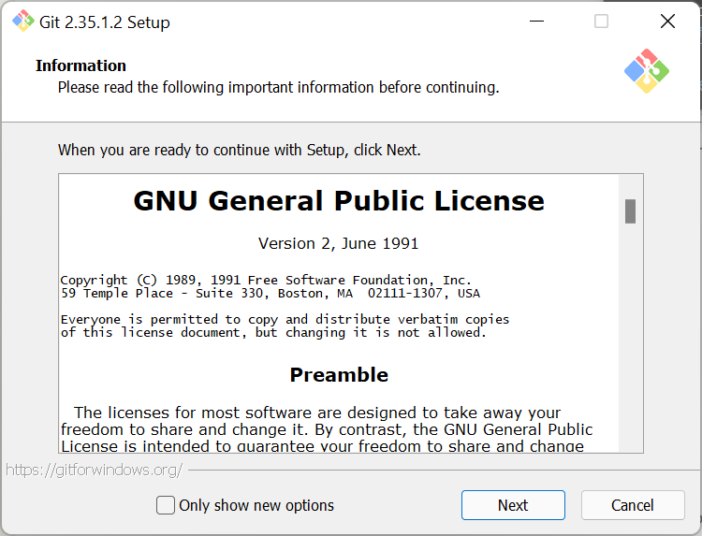
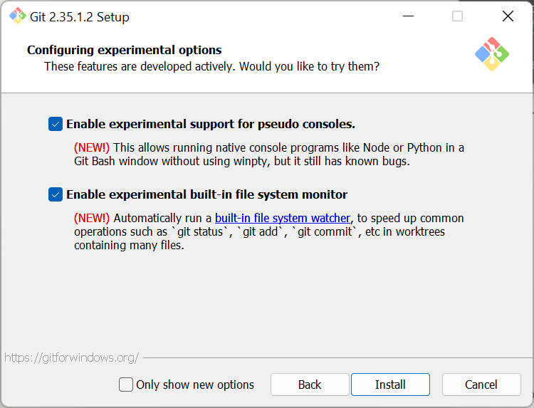
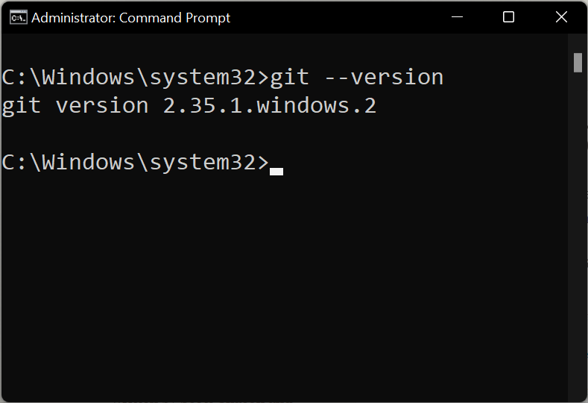
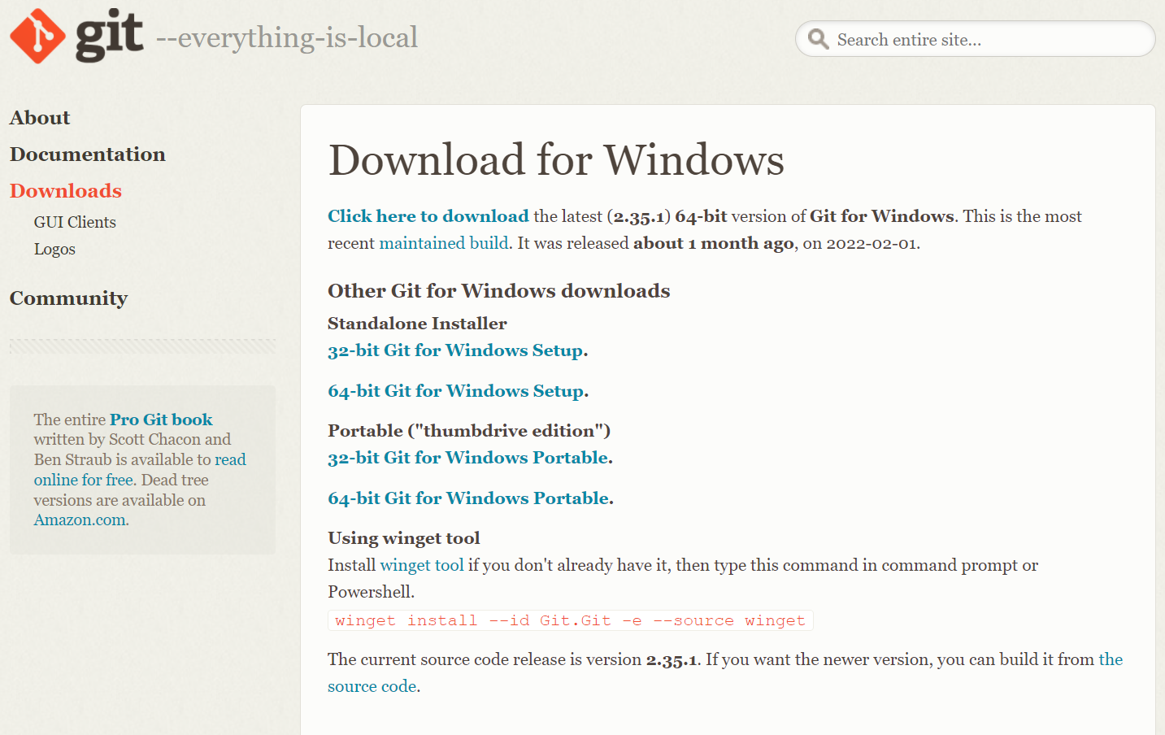
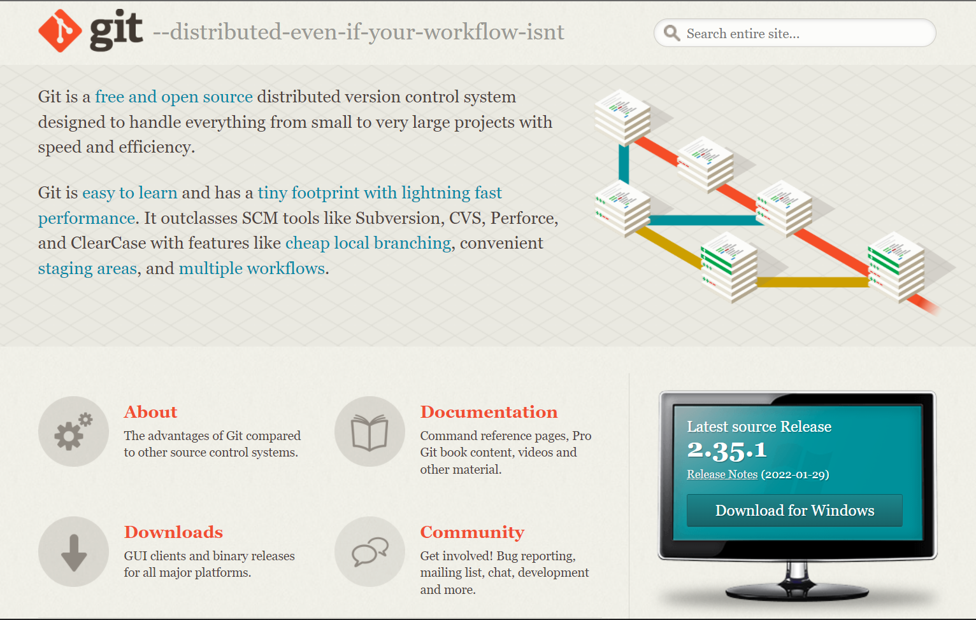
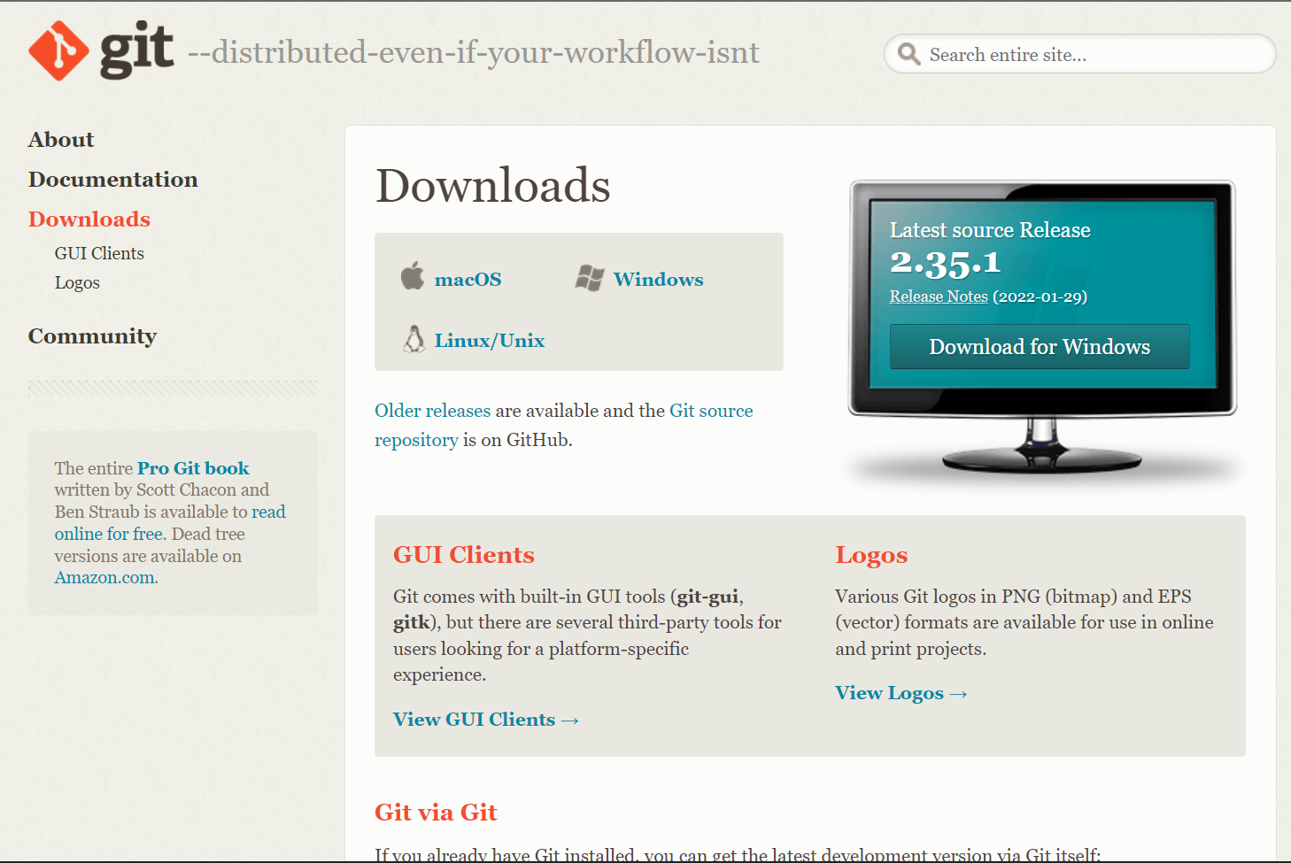
Steps to Install:
On Windows:
On any browser, Open the site: https://git-scm.com/
Click on Downloads Button
Select your Windows Operating System.
Click on Standalone Installer links according your system Preference.
After git-2.35.1.2-64-bit.exe application will be downloaded. Run the Application and press Next without changing anything and at last press Install.
Now Git is installed on your system. To check you can run following command on Command Prompt or PowerShell:
git --version

Slide 13
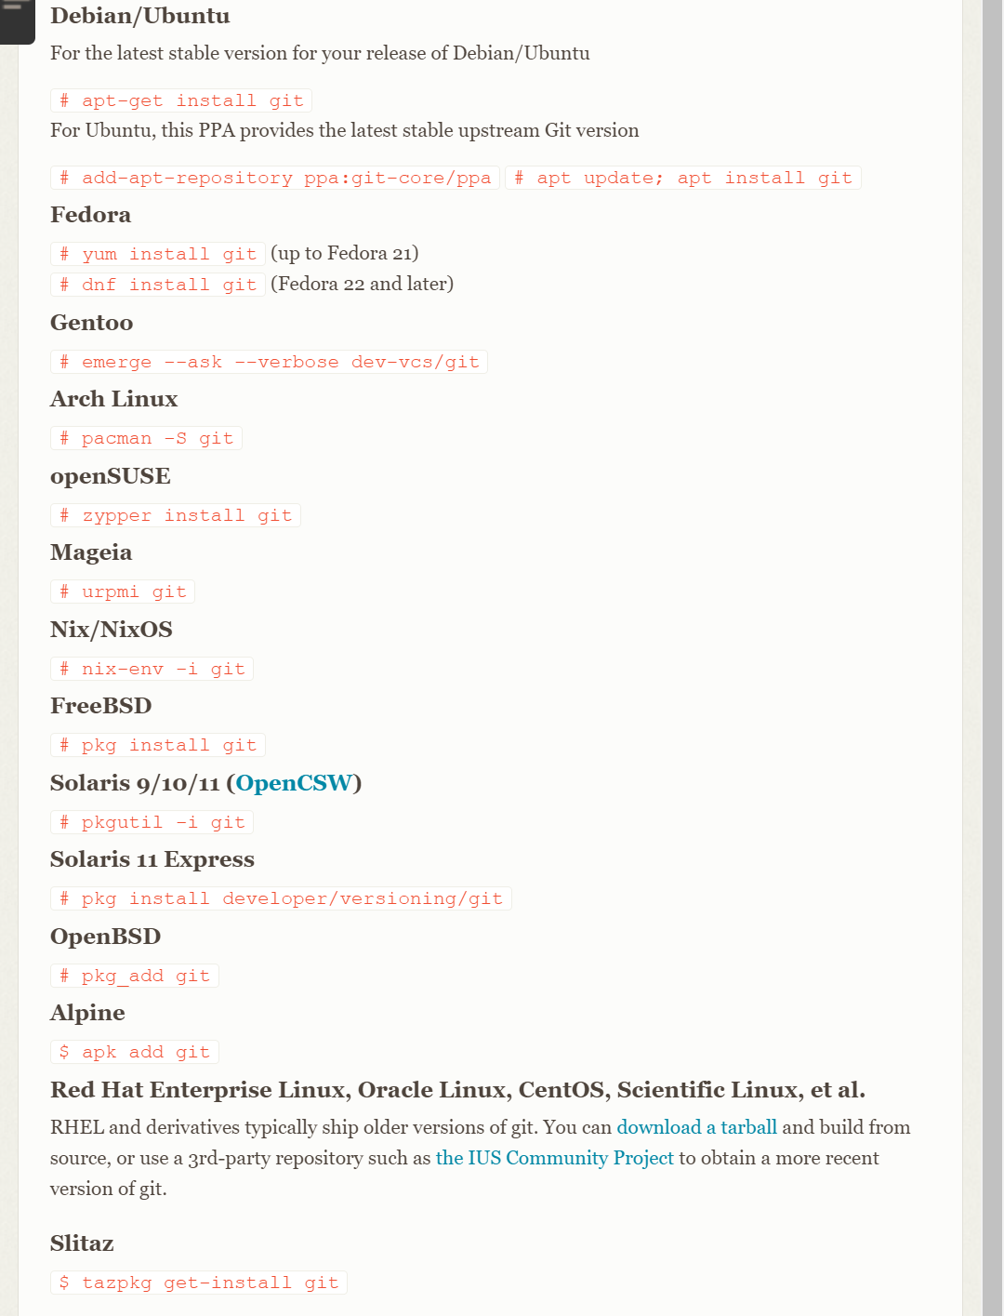
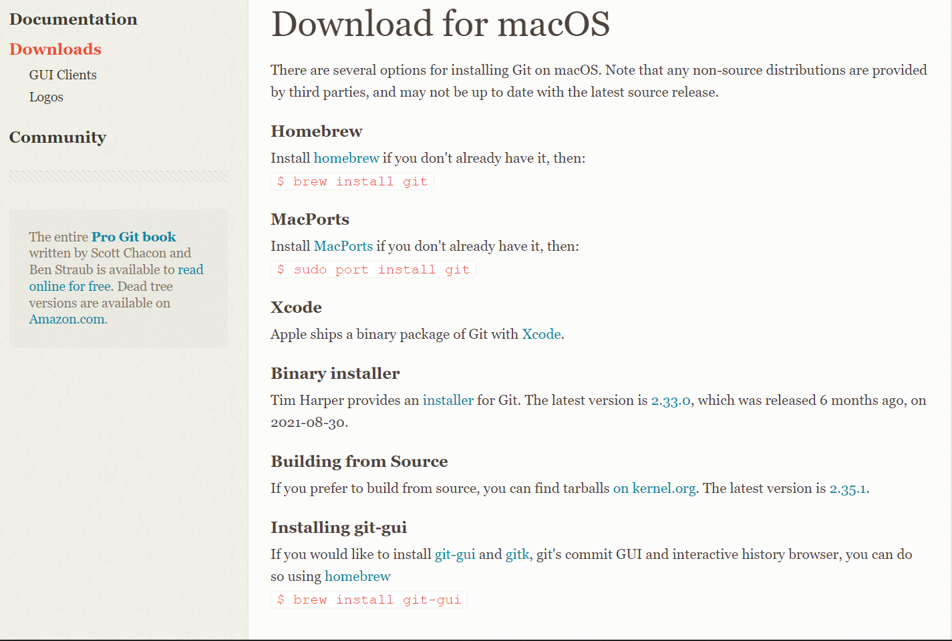
Steps to Install:
On MacOS /Linux/Unix:
On any browser, Open the site: https://git-scm.com/
Click on Downloads Button
Select your desired Operating System.
For Mac:
Run the terminal commands to install git in your system.
For Linux/Unix:
Run terminal commands according to you kernel to install git.
Now Git is installed on your system. To check you can run following command on Terminal:
git --version

Slide 14

Configuration of Git
How to Configure Git!!

Slide 15
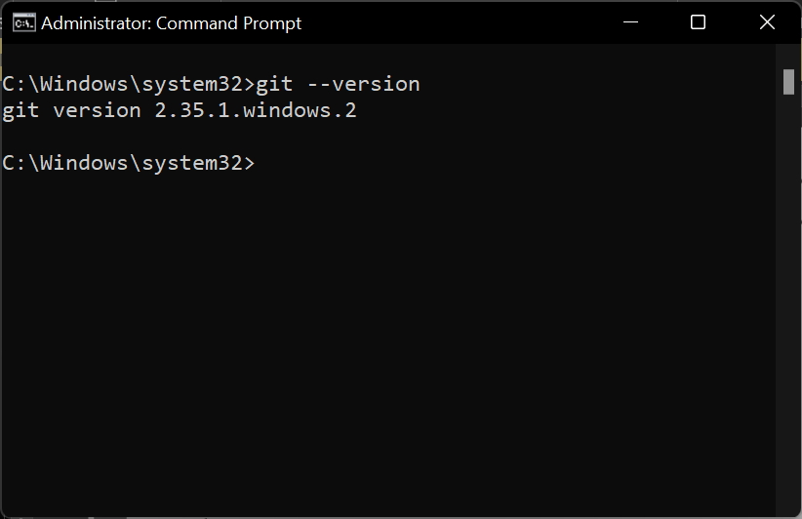
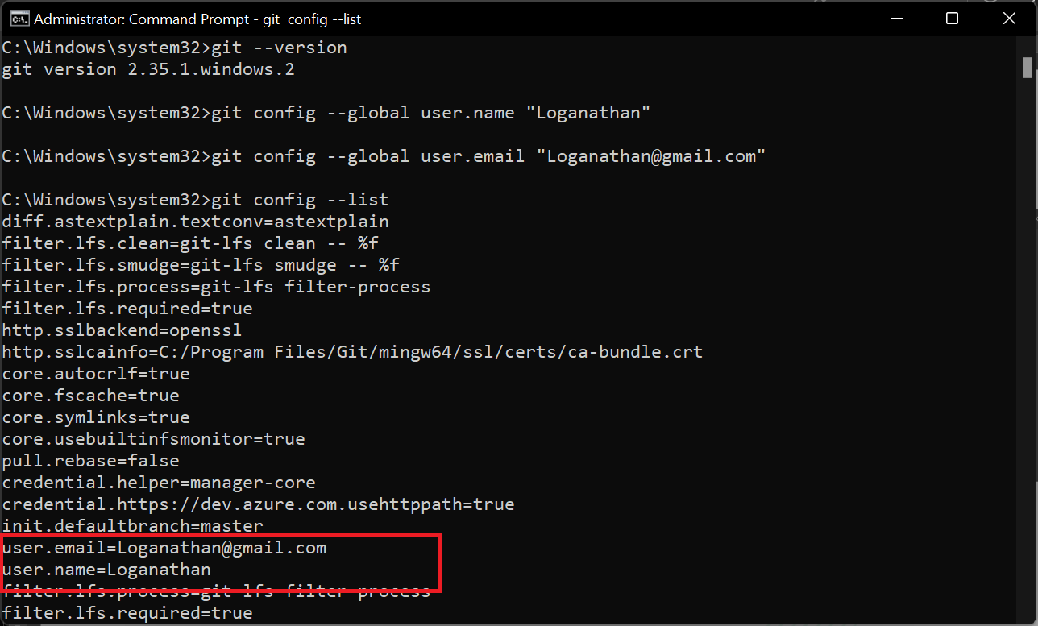
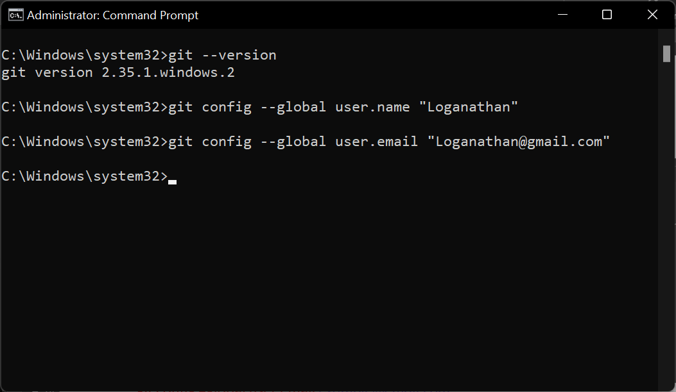
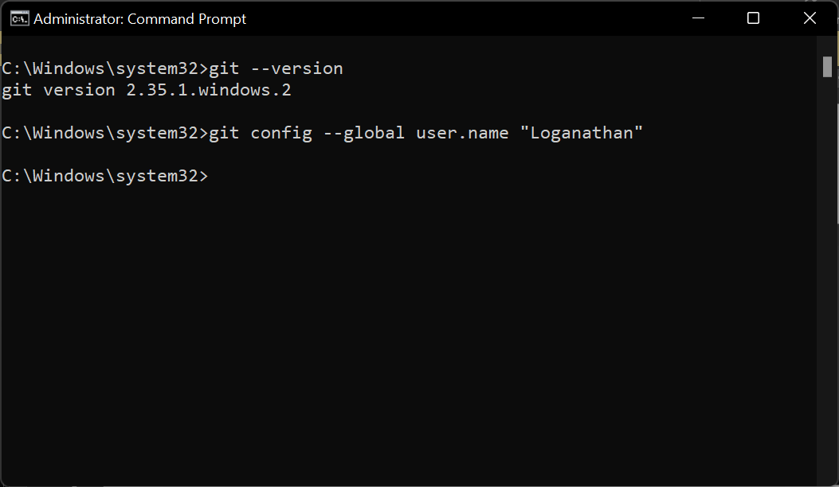
Steps to Configure:
Configuration of git is an important part for using all features of Git Repository.
To use git at its full potential we have to configure a user id to git.
Once Git is installed:-
Open Command Prompt/PowerShell on Windows.
Open Terminal on MacOS/Linux/Unix.
Creating a new user on git.
Set User-Name:
git config –global user.name “name”
Set User-Email:
git config –global user.email example@email.com
List all the user who have configured on git.
git config --list

Slide 16

Working with Git Repository

Slide 17
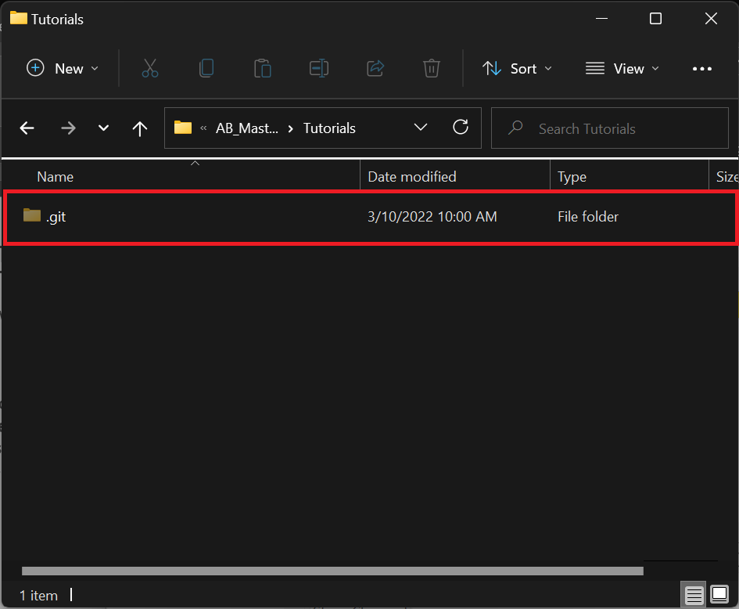
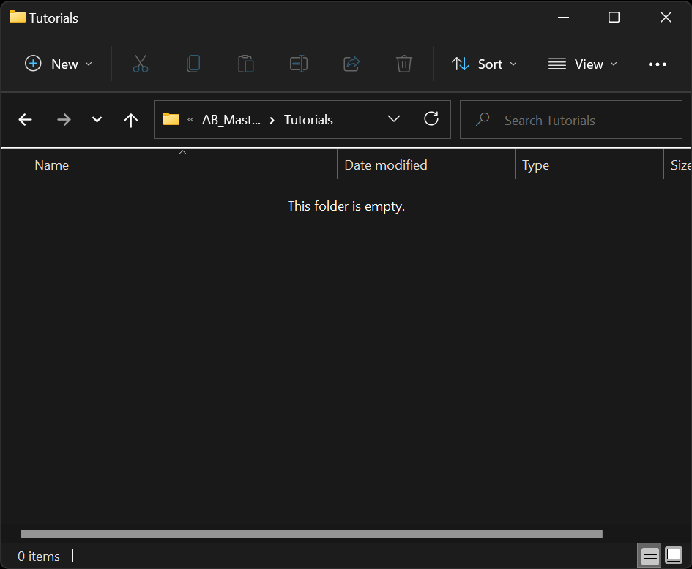
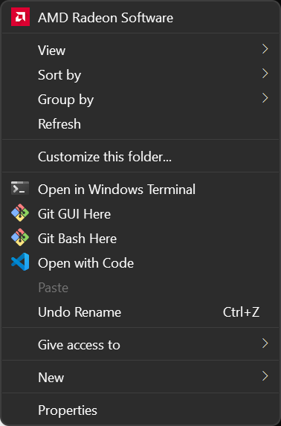
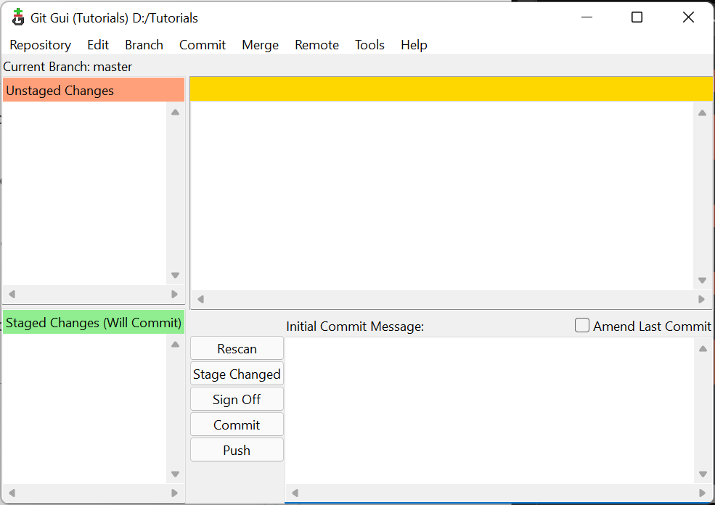
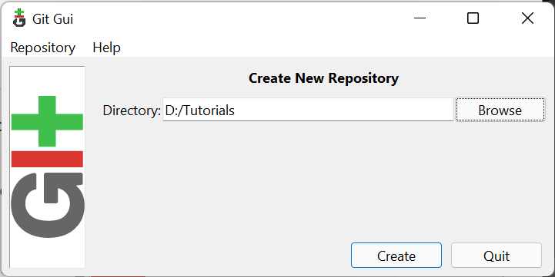
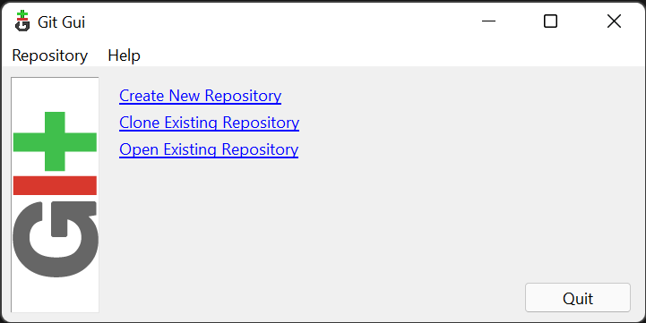
Initiating Git:
Before Initiating a Git user must know on which directory Git must be initialized. Here, we will be using directory named ‘Tutorials’.
Steps to Initialize Git in Directory-
Open ‘Tutorials’ directory, Right click inside the directory and click on GIT GUI Here.
Now Click on Create New Repository.
Now Click on Browse and click on Select Folder. Click on Create.
Our git have been initialized on our directory.
Now if We make any changes in our ‘Tutorial’ Directory it will show in Git GUI.

Slide 18
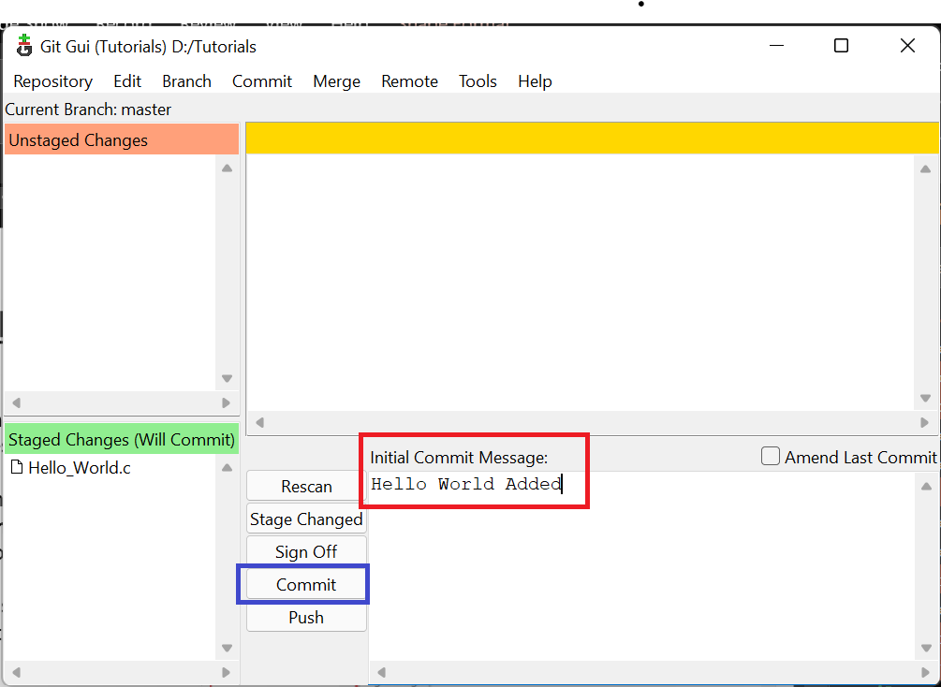
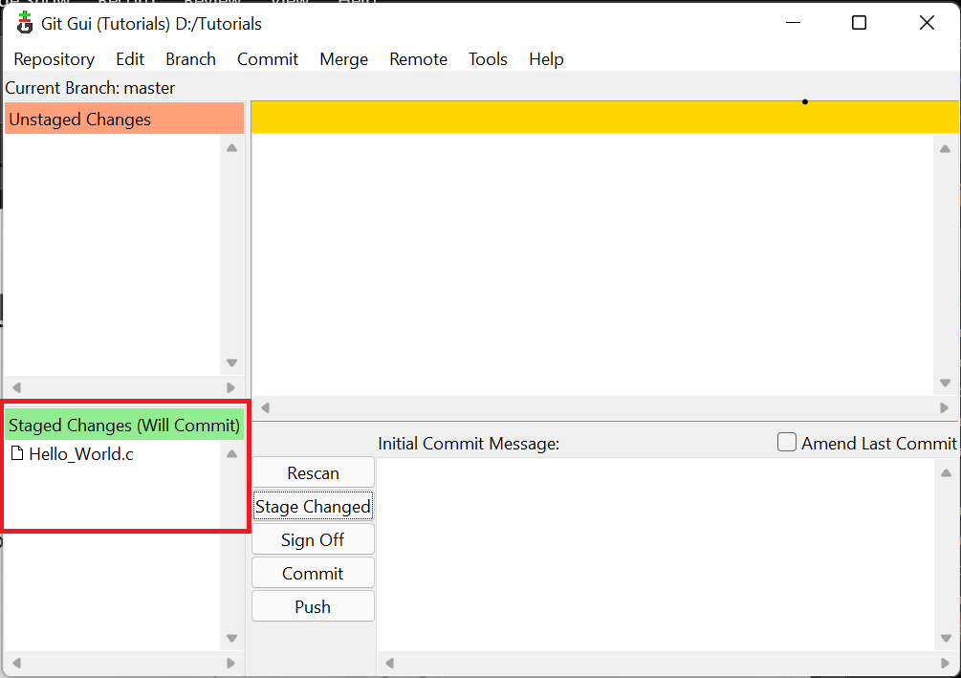
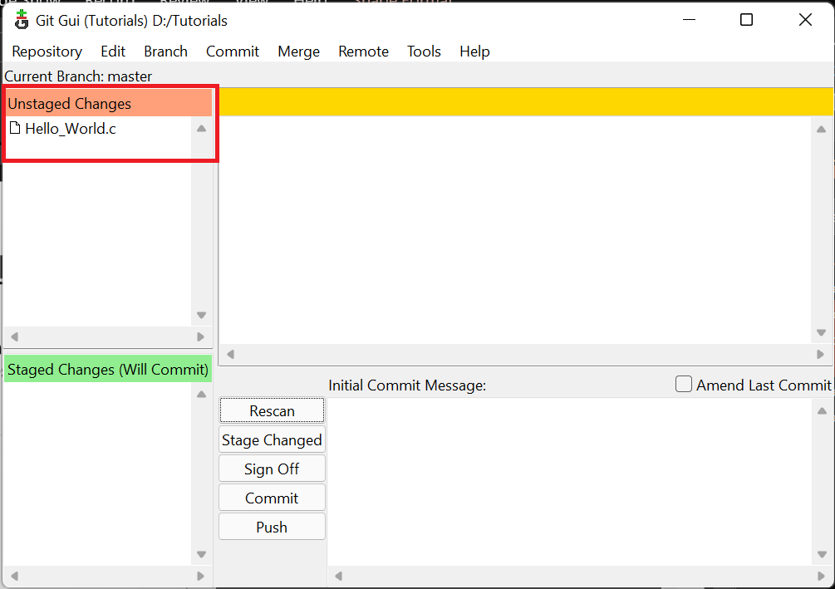
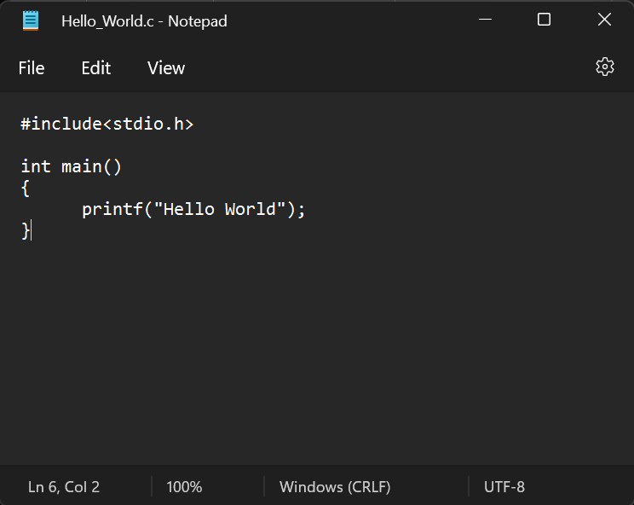
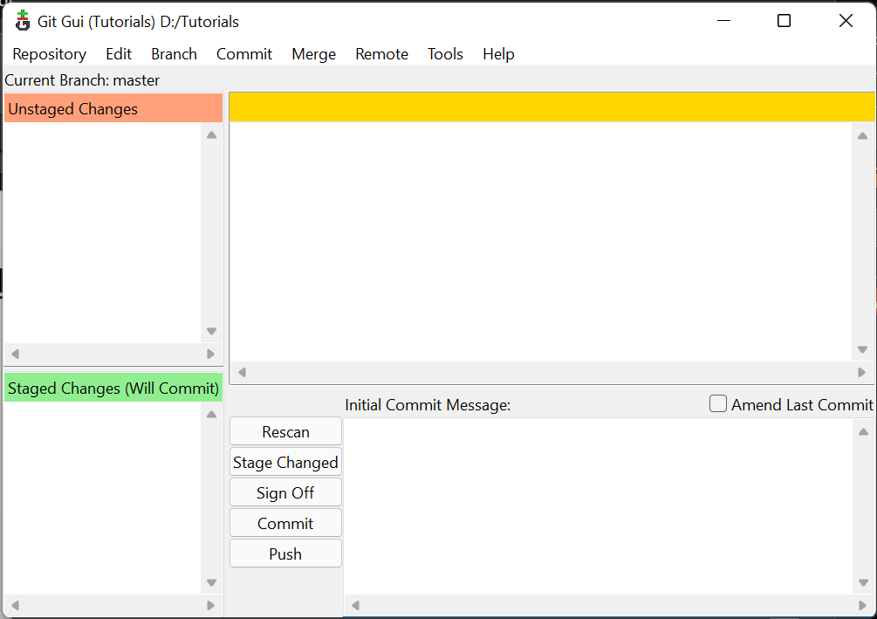
Staging/Committing in Repository
For Now we don’t have any changes in our directory.
If we create a file with random name.
In Git GUI, we can see the changes made in our directory.
Now to save the changes made in Working Directory to Staging area, click on Stage Changed.
User can see that, changes are now uploaded to Staged area.
Now, for final committing and to save the changes record in git database, User must give a commit message and click on Commit
Now there will be nothing to commit as all changes are recorded.

Slide 19
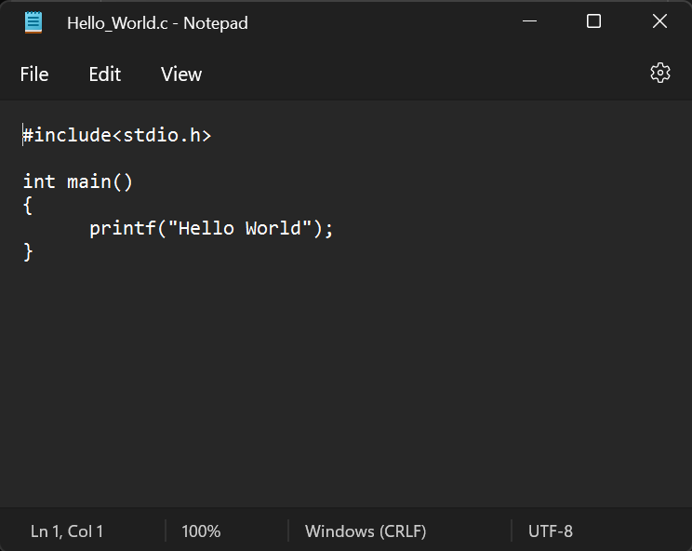
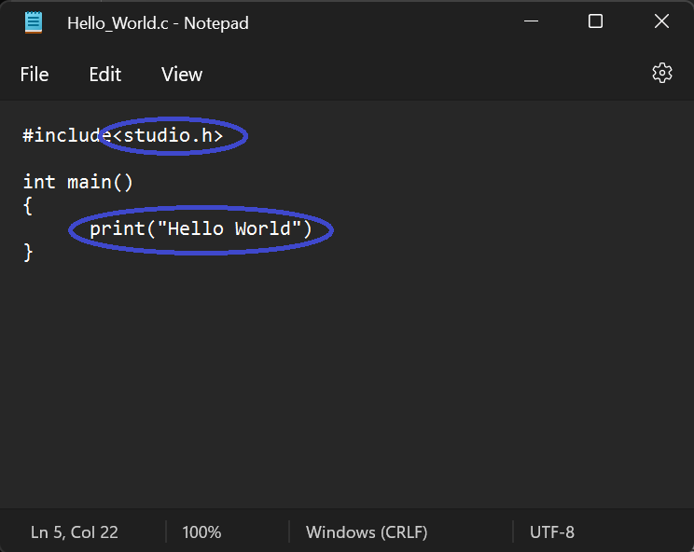
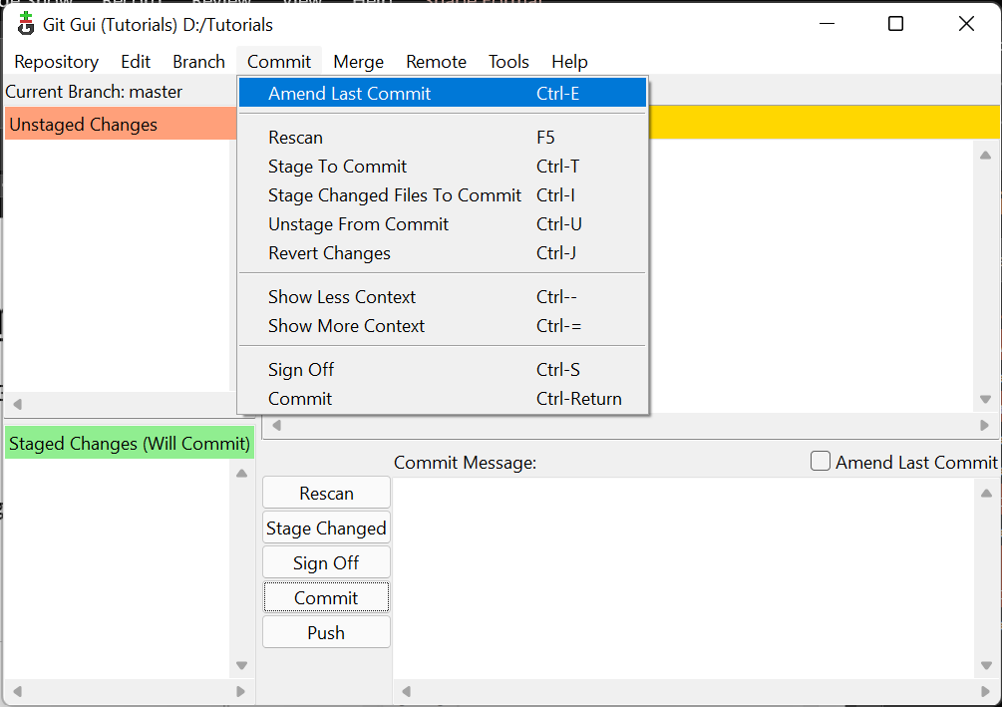
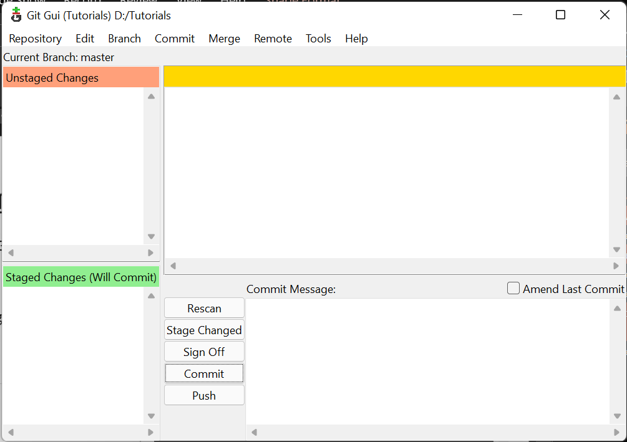
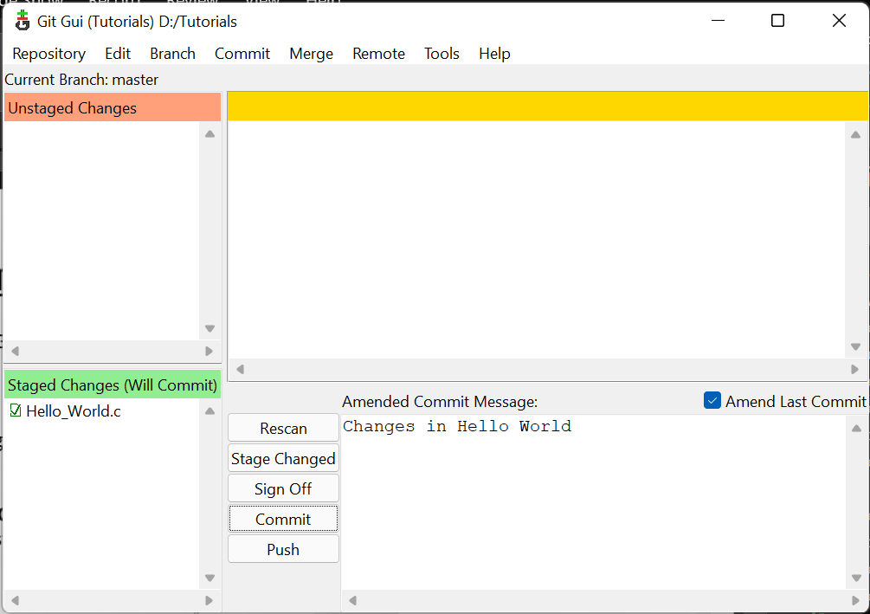
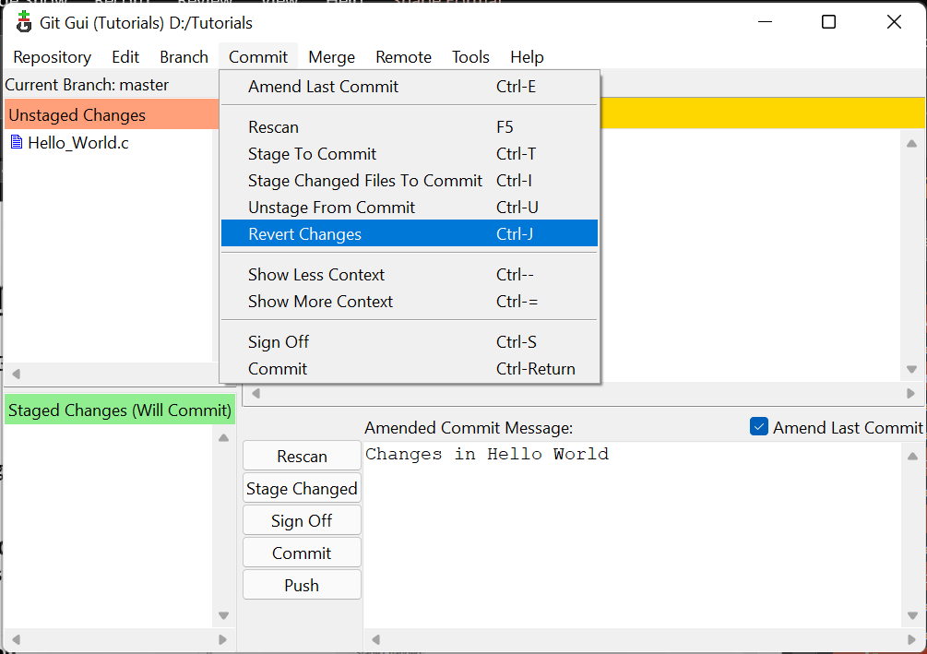
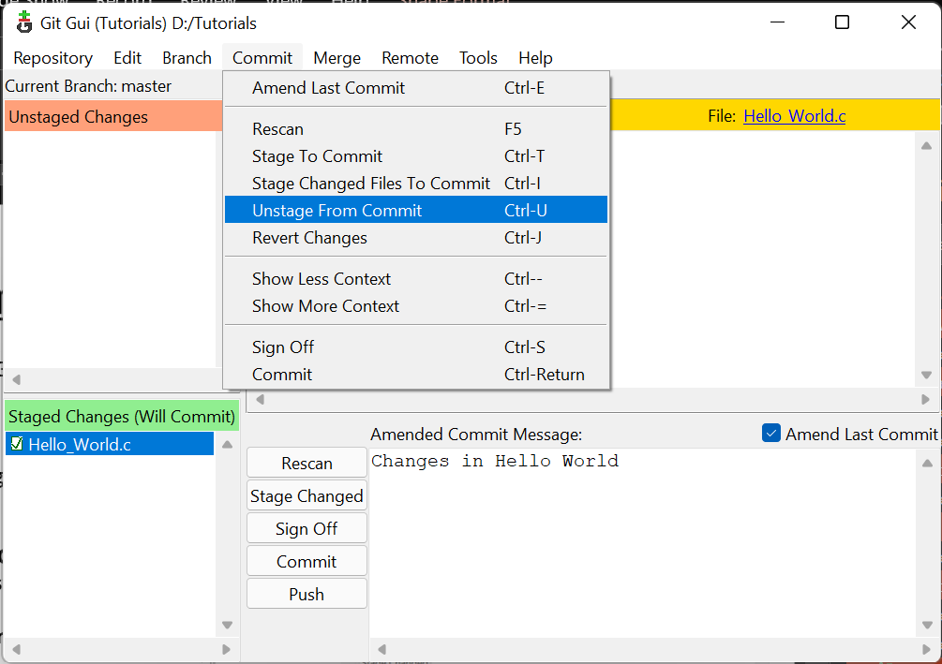
Amend Commit & Un-staging
Now We will try to understand why Git is an important for any software development
Let’s assume that we made a wrong changes in our file and committed it in git.
Now to recover previous version of git repository. Follow the steps below:-
Open GIT GUI.
Click on Commit > Amend Last Commit.
Now last committed Files are restored and removed from git database.
Select the file which you have to unstage & Click on Commit > Unstage From Commit.
To revert changes made in file click on Click > Revert Changes > Revert Changes.
Your file will be reverted to previous version.

Slide 20
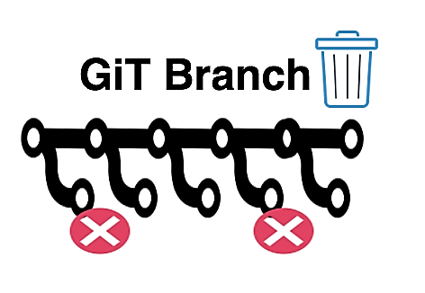
Working with Git Branches

Slide 21

Branches in Git
A branch is a version of the repository that diverges from the main working project. It is a feature available in most modern version control systems. When you want to add a new feature or fix a bug, you spawn a new branch to summarize your changes.
The master branch is a default branch in Git. It is instantiated when first commit made on the project. When you make the first commit, you're given a master branch to the starting commit point. Master branch is the branch in which all the changes eventually get merged back. It can be called as an official working version of your project.

Slide 22
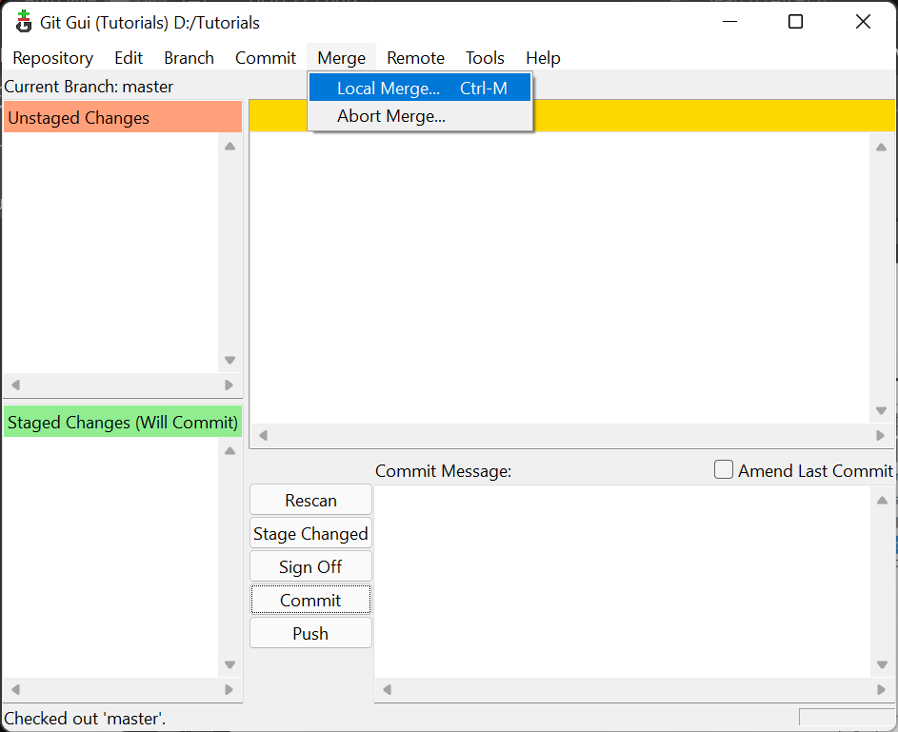
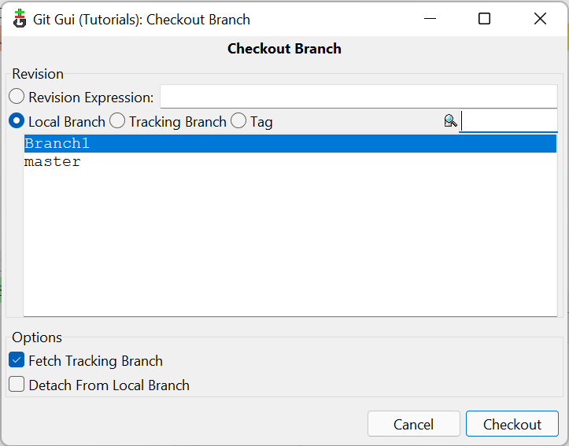
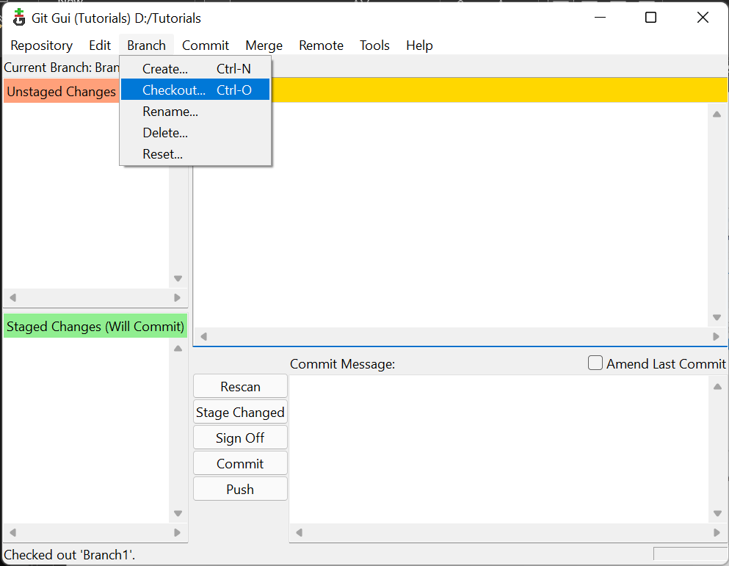
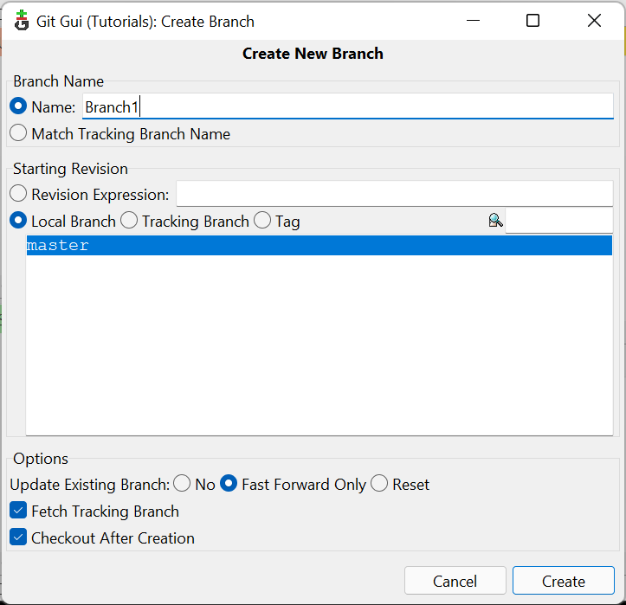
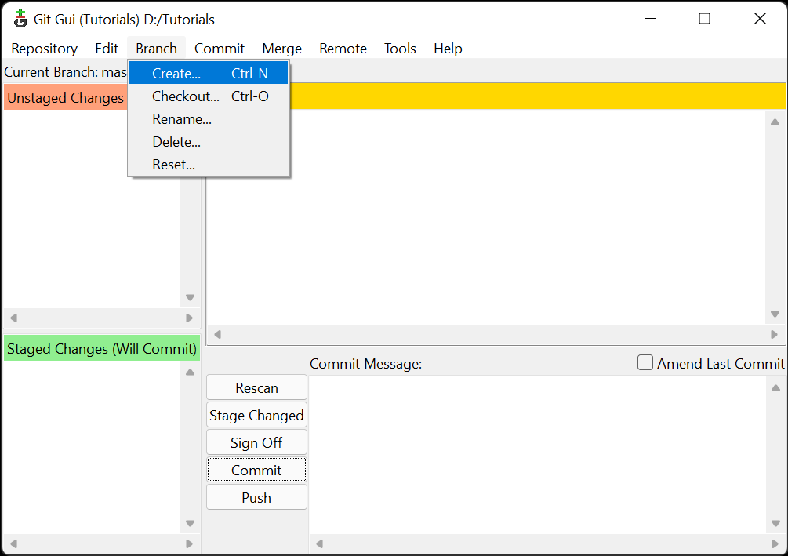
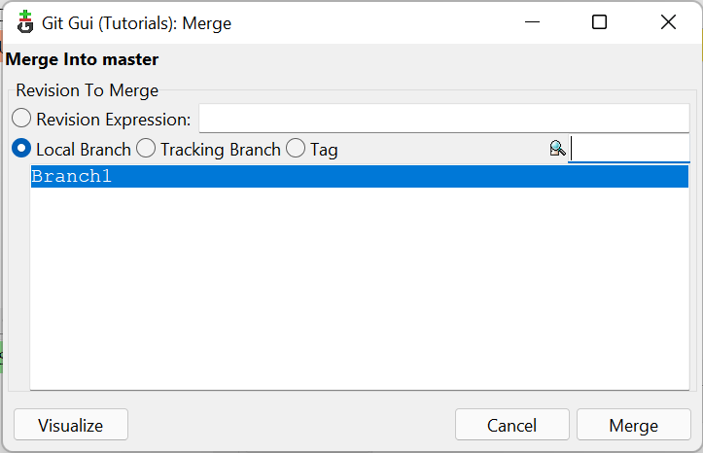
Operation on Git Branches
Create a New Branch:
Click on Branch > Create.
Enter Name inside Branch Name tab and Click on Create.
New Branch will be available.
Change Working Branch:
Click on Branch > Checkout
Select the Branch on which you want to change and click on Checkout.
Working branch will be changed.
Merging Branch after changes:
Click on Merge > Local Merge
Select the Branch which you want to merge and click on Merge.
Working branch will be merged into master.

Slide 23
Additional Git Commands
Below Given are some additional git commands which a user can use on terminal or command prompt as to use additional git features.
GIT Command | Description
git init | Initialize a new git repository
git status | View the status of your files in the working directory and staging area
git add -a | Add all files to staging area of a git repository
git commit –m [message] | Commit all the files in staging area with a commit message
git diff | Shows difference of what is staged and what is modified but unstaged
git help [command] | Get help info about a particular command
git pull | Fetch from a remote repo and try to merge into current branch
git push | Push you new branch and data to a remote repository
git log | Shows commit, author, date and time or committing the message
git branch | Give access to access different git branches
rm –rf .git | Delete a git repository from current directory

Slide 24

Basics of GitHub
What is GitHub!!
This Photo by Unknown Author is licensed under CC BY-SA

Slide 25
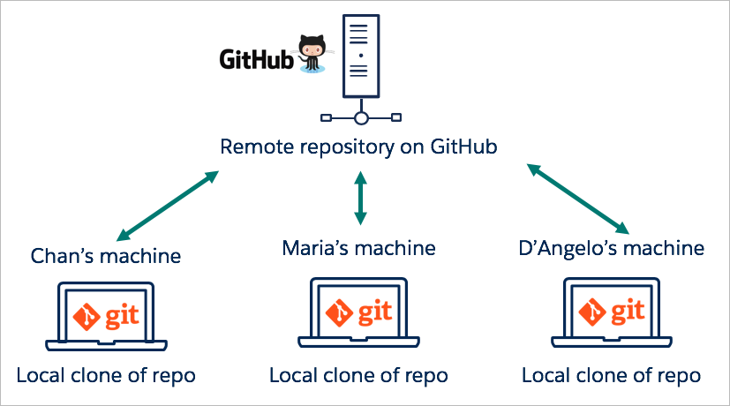
What is GitHub??
GitHub is a for-profit company that offers a cloud-based Git repository hosting service. Essentially, it makes it a lot easier for individuals and teams to use Git for version control and collaboration.
Additionally, anyone can sign up and host a public code repository for free, which makes GitHub especially popular with open-source projects.
GitHub essential are:-
Repository
Branches
Commits
Pull Requests
Git

Slide 26
Working with Remote Repository
GitHub Repository
This Photo by Unknown Author is licensed under CC BY-SA

Slide 27
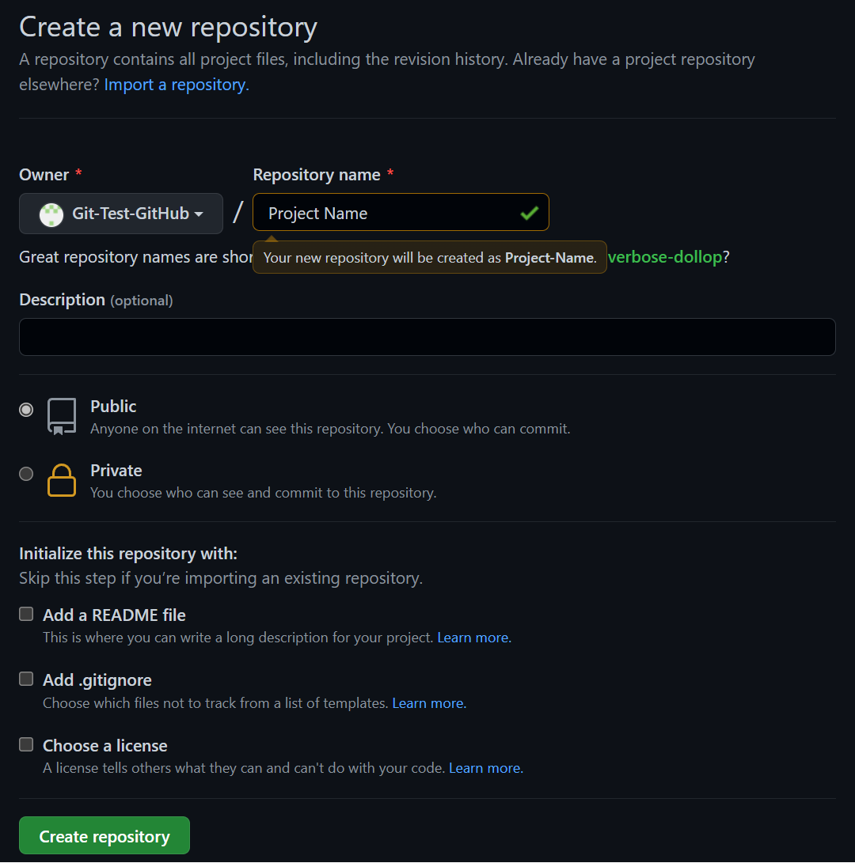
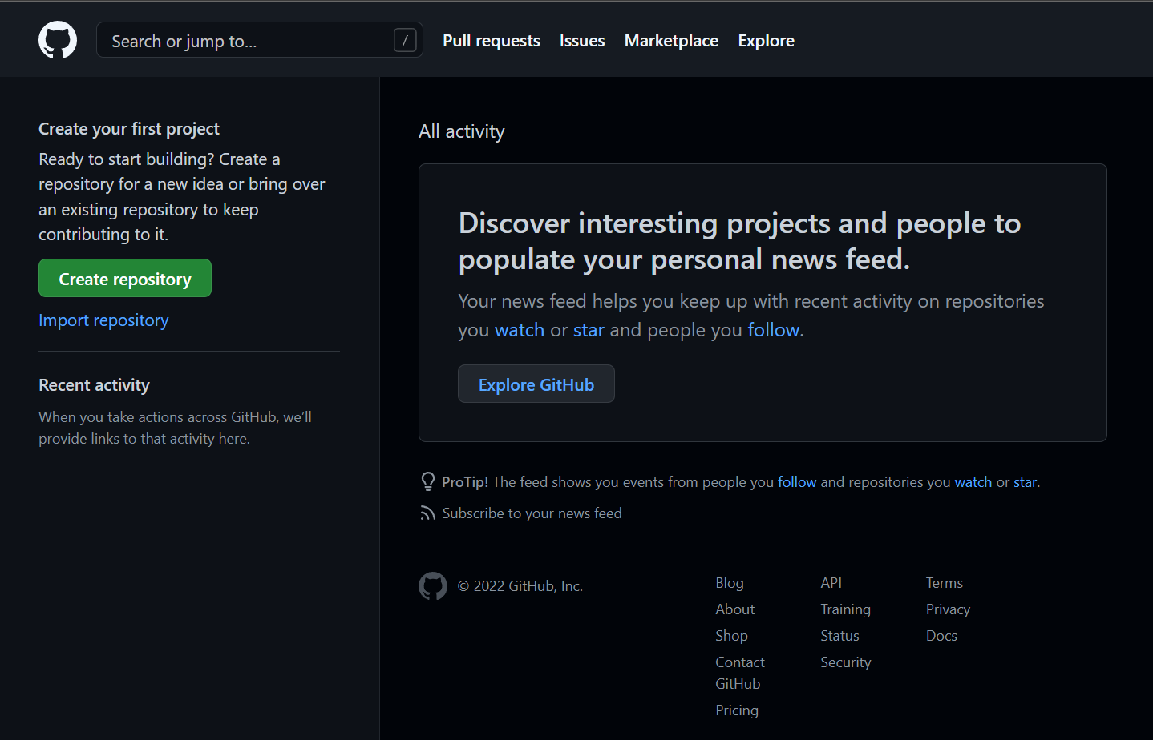

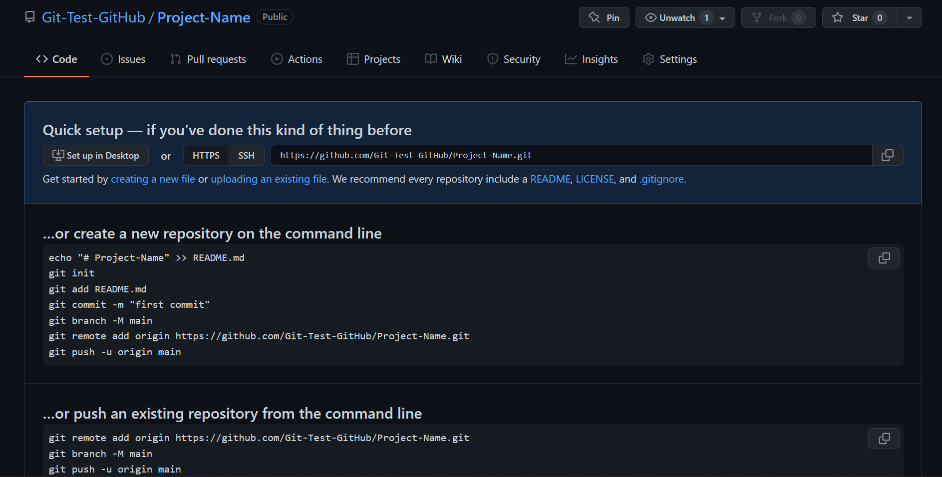
Creating GitHub Repository??
Creating GitHub Remote Repository:-
Search GitHub on google and click on first link.
Sign in To your account.
Click on Create Repository.
Give Project Name as Repository name.
User can choose to keep repository as public or private.
User can click on to Add a README file to add README.md file in there in repository.
User can click on Add .gitignore to add .gitignore file in there git repository.
GitHub allows users to set a license for there repository by Choosing a license for repository.
4. Your GitHub Repository is successfully created. And will be available on Project-Link.

Slide 28
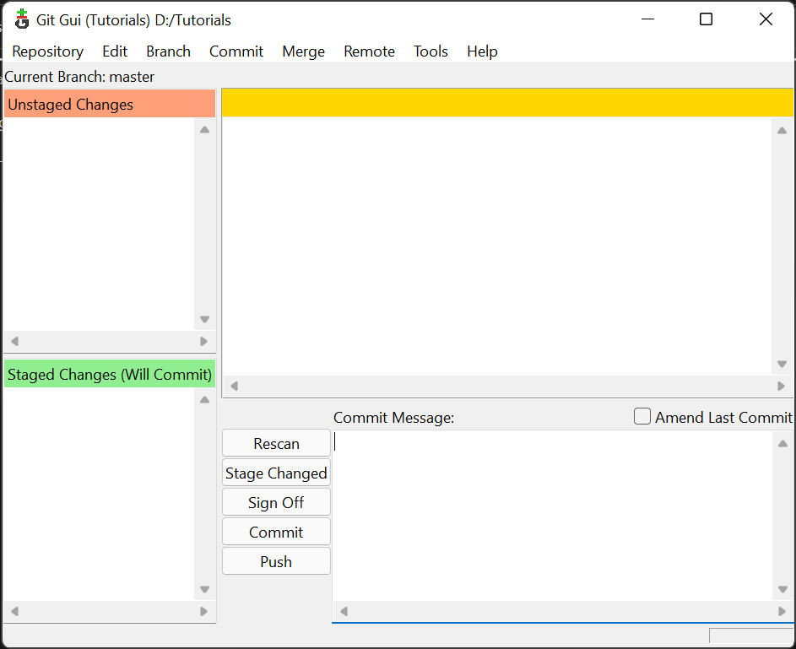
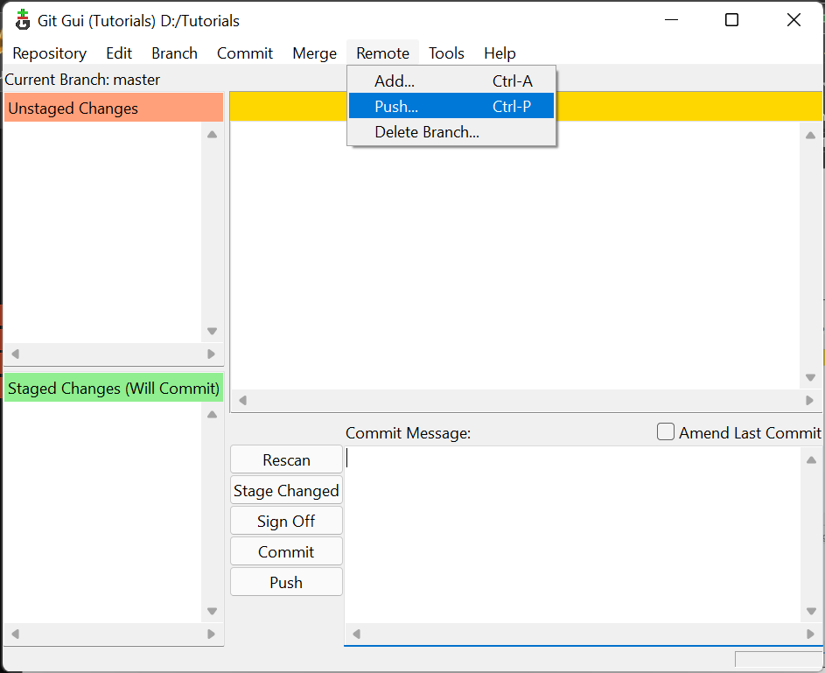
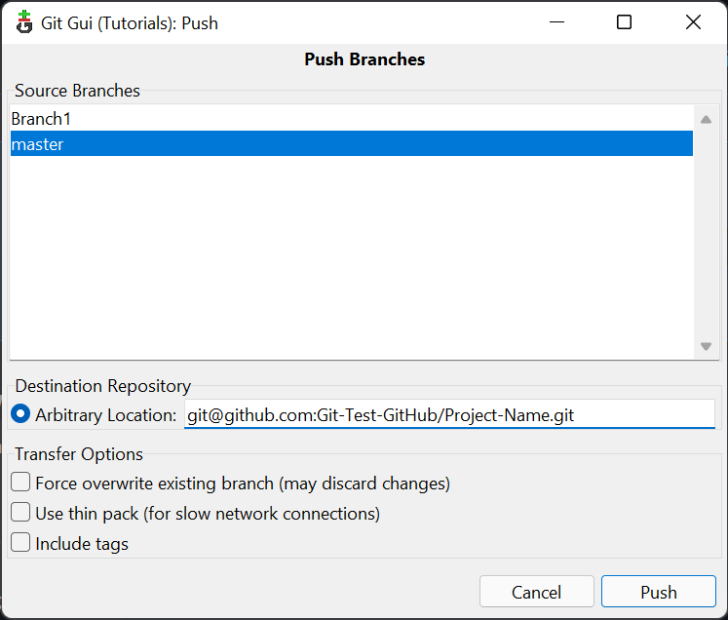
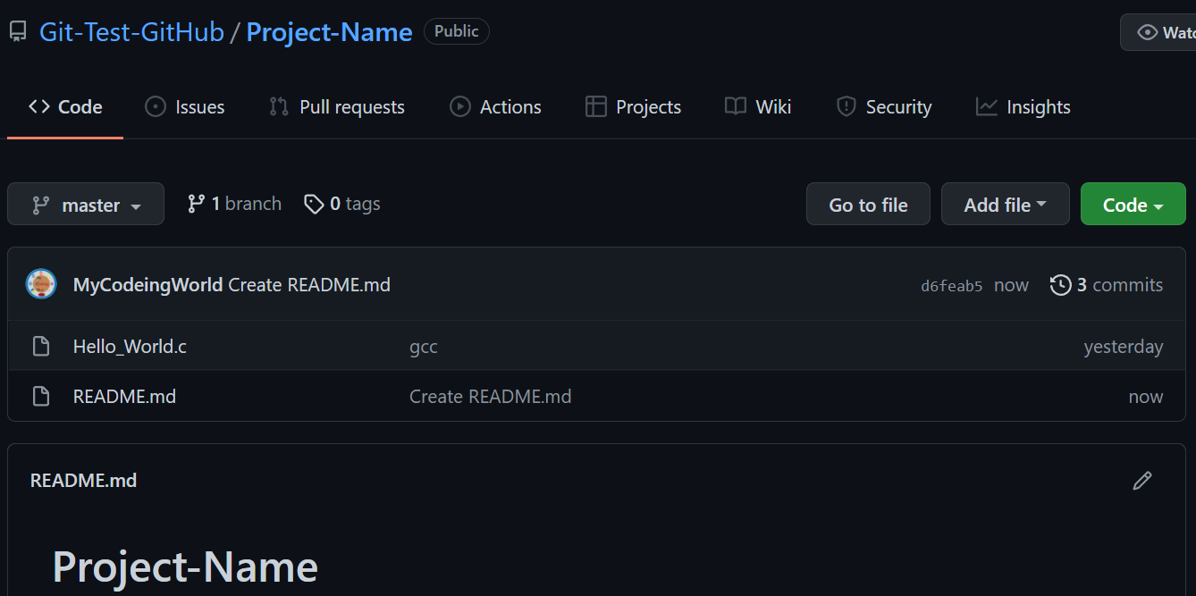
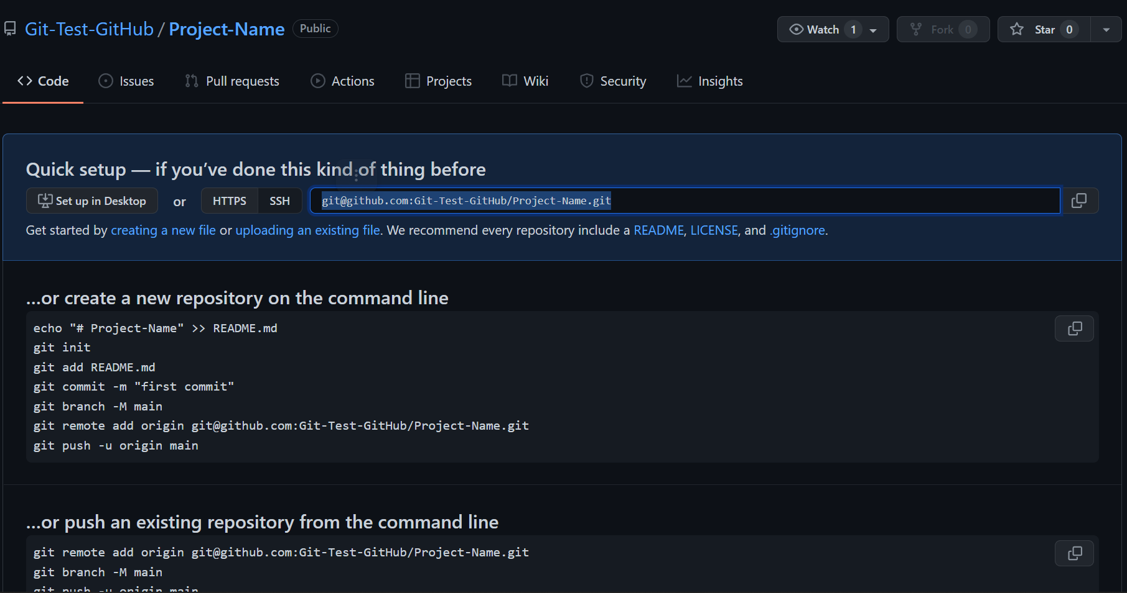
Pushing to Remote Repository
Pushing Local Repository to Remote Repository:-
Open the Project using Project Link or from GitHub Account.
Copy the SSH Id as shown.
Now open Git GUI in directory where the local git is present.
Click on Remote > Push…
Click on Source Branch which you want to add and paste SSH ID in Arbitrary Location, and Click on Push.
Your local Repository will be pushed to remote repository.

Slide 29



Clone Remote Repository
Clone Remote Repository to Local Repository:-
Open the Project using Project Link or from GitHub Account.
Copy the HTTPS Link as shown.
Now open Git GUI in directory where we want to clone our remote repository. (Make sure directory should not contain any previous git repository)
Click on Clone Existing Repository
In Source Location, paste the HTTP Link. In Target Directory, give location of directory where we want to clone following with remote repository name.
Click on Clone to start Cloning
Your Remote Repository will be cloned to local repository.

Slide 30

Link to This Presentation
Link QR Code
GitHub Link: https://github.com/logu73/Git-Presentation.git
This Photo by Unknown Author is licensed under CC BY-SA

Slide 31

THANK YOU
Dr. Loganathan R
loganathanr.cs@hkbk.edu.in

